Slide 1

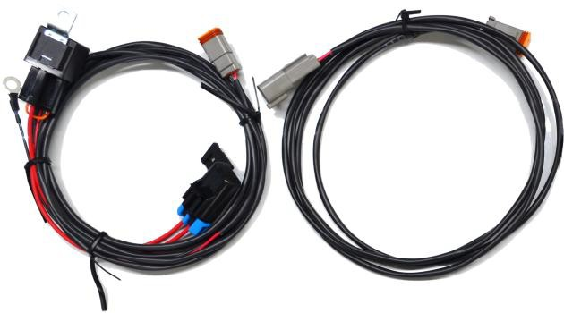
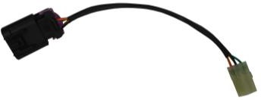
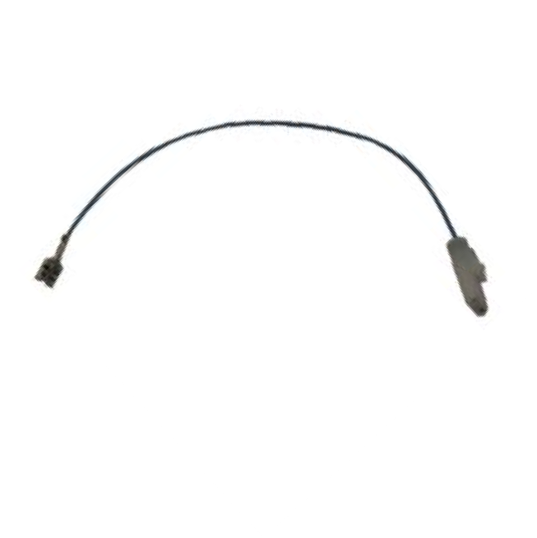

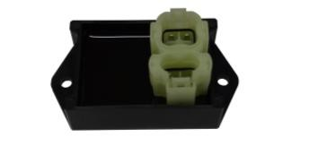


Polaris Ranger Reverse Light Ki t
287-109 Installation Manual
Light plug
Relay
Negative Lead
Fuse Holder
Light plugs
Diagnostic Connector
Positive Lead
Relay
Christmas Tree Zip Ties
& 2-Pin
Mini Controller
Battery Nuts
13mm Socket
10mm Socket
Flat-Head Screwdriver
Torx T-40
Allen Wrench #6
Wire Cutter (trimming zip ties)
Required Tools:
Zip Ties
Read entire manual before beginning the installation process.
Disclaimer: Straightline Performance is not responsible for any damage due to improper installation.
Straightline Backup Lights Straightlineperformance.com 287-109
Polaris Ranger Reverse Light
Tech@straightlineperformance.com 1 of 4
V4

Slide 2
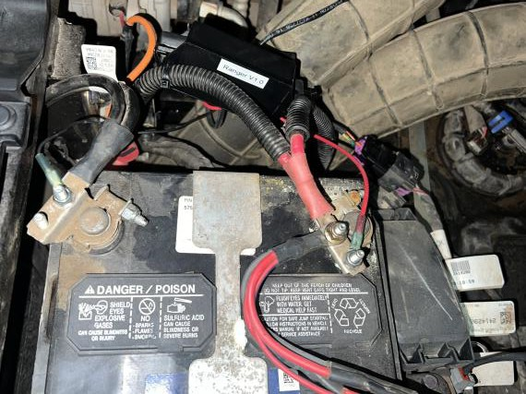
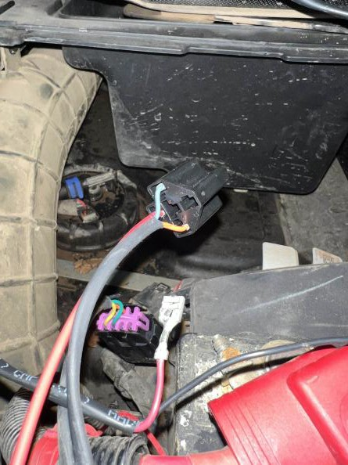
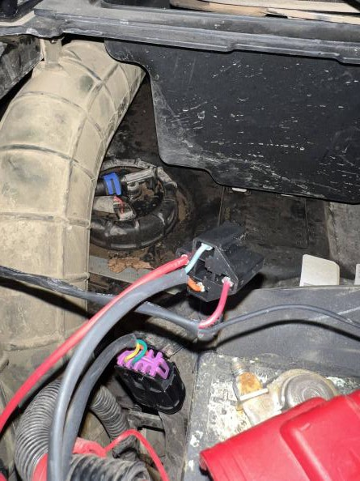
Step 1 : Routing Wires
Run harness from battery compartment to light as desired, making sure to keep harness away from hot or moving components at all times; following the OEM harness is typically best.
Zip tie harness as needed.
Step 2 : Connect Diagnostic Connector & Power Leads
Push relay terminal into remaining slot of relay holder; then plug relay in.
Remove diagnostic connector cover and plug in connector that comes with reverse light wiring harness.
Connect positive lead to positive terminal of battery and negative lead to negative terminal using supplied locknuts.
Diagnostic connector
Straightline Backup Lights Straightlineperformance.com 287-109
Polaris Ranger Reverse Light
Tech@straightlineperformance.com 2 of 4
V4

Slide 3
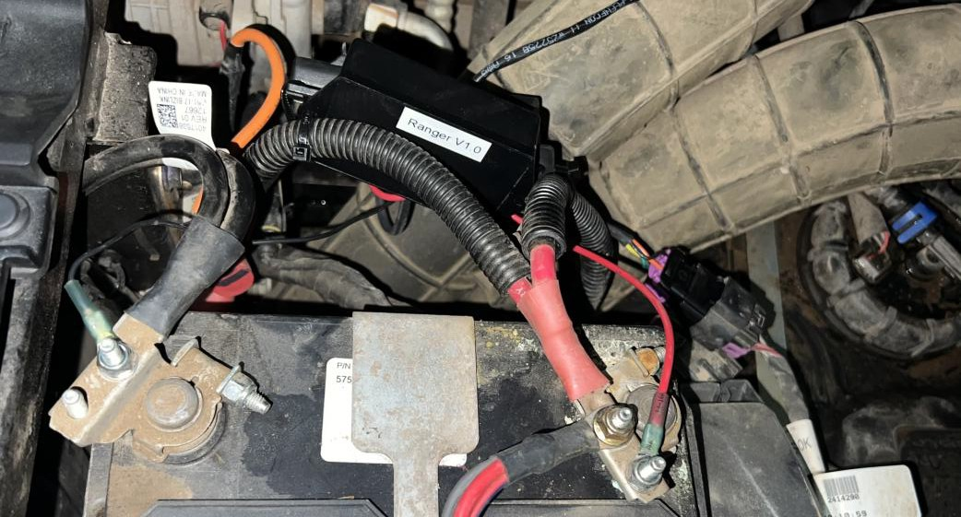
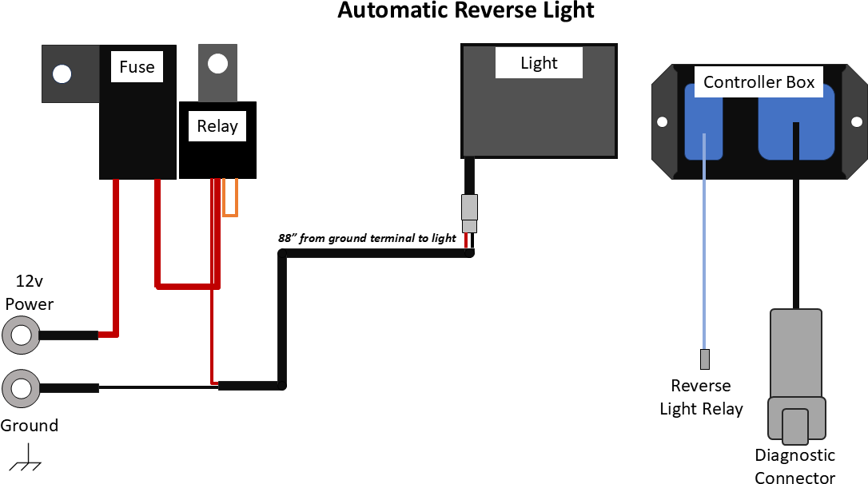
Step 3 : Secure Control ler, Relay, & Fuse
1) Secure the fuse, controller, and relay using zip ties.
Straightline Backup Lights Straightlineperformance.com 287-109
Polaris Ranger Reverse Light
Tech@straightlineperformance.com 3 of 4
V4

Slide 4
Operation of Reverse Lights
Our controllers have been programmed with a manual override feature. Back-up lights may be turned on without the vehicle in reverse.
Fully Automatic When Shifted to Reverse
  No programming needed
Manual Override
Put the vehicle in neutral.
Press and hold the brake pedal for up to 2 seconds. The reverse light
will automatically turn on and stay on.
*To turn the light off repeat this procedure.
Note: If the ignition is turned off while the vehicle is in reverse, or the manual override function is enabled, the lights will remain ON until the ECU enters sleep mode (approximately 30 seconds - 2 minutes depending on vehicle and ECU type).
Part Number | Description | Quantity | In Box
IT-238-105 | Battery nut 6mm | 2
IT-287-100 | 60" wire harness, single connector for light, battery terminals, includes relay | 1
IT-287-102 | Polaris Diagnostics Adapter Purple and black 8 pin plug on one end and 4 pin white plug on the other. | 1
IT-287-105 | Controller | 1
IT-287-110 | Blue 4" jumper from harness relay to controller, 2 pin plug on one end flat locking spade on other. | 1
IT-288-102 | Zip tie with Christmas tree end | 2
IT-288-105 | Bagged female Deutsch connector with pins seal and lock. | 2
Np-209 | zip ties, zip tie length 6” | 10
 | insert blue wire into relay housing. Directions in folder (SPI in house)
Sticker |  | 2
Directions |  | 1
Straightline Backup Lights Straightlineperformance.com 287-109
Polaris Ranger Reverse Light
Tech@straightlineperformance.com 4 of 4
V4

